Slide 1
Objectives
To discuss the history of computer virus outbreaks.
To examine the difference between computer worms and viruses.
To discover the various types of computer worms and viruses and how to protect a computer.
To assess the consequences associated with computer worms and viruses.

Slide 2
Main Menu
Introduction to Computer Worms & Viruses
History of Computer Worms & Viruses
Protecting Against Computer Worms & Viruses

Slide 3
Introduction to Computer Worms & Viruses

Slide 4
A Computer Virus
Is a ______________ computer program created by a user with objectives to _______ or _________ another’s property
Is also referred to as ______________
Is important for users to be aware of
Computer _________: a malicious computer program ____________ by a user with objectives to harm or steal another’s _______________

Slide 5
A Computer Virus
Is a piece of _______ attaching itself to a larger, more frequently used program
it then ______________ the program
this is referred to as “__________________”
Is active and running only when the _______ program is active
Is designed to _____________ and __________ other programs the computer runs
Protect themselves by hiding in a host program
________ Program: a large, frequently run program attached to the virus
Piggybacking: the act of a computer virus ______________ itself to another computer program

Slide 6
A Computer Virus
Begins to carry out whatever malicious activity it is supposed to, _______ it has multiplied and infected _________ programs
the malicious activity is known as the __________
Can spread _______, slow or _____ spread at all
if the virus programmer made an error in designing the virus then it will not spread at all
Can remain _______________ in a computer until a specified time
Can delete _____ data and files on a computer
Payload: the malicious ____________ a computer virus or worm is designed to _____

Slide 7
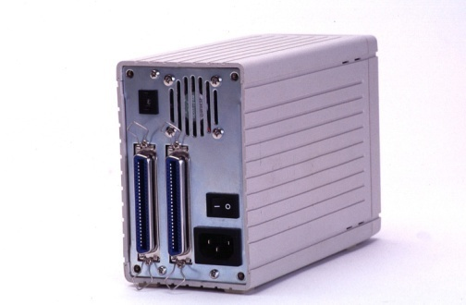
A Computer Virus
Can affect _____________ parts of the computer
such as:
the ________ drive
a _____________ drive
any type of ____________ device
Can spread through virtually ____ computer to server or computer to computer contact
Examples of ___________ medians:
_______________
_______________ attachments or music
CD or __________ drive

Slide 8
A Computer Worm
Is an _________________ program
it does ____ attach itself to files or programs
Is classified by two types:
a ___________ worm
a ______ worm
Computer ______: an independent program which multiplies itself by ___________ a ____________ of itself onto another computer

Slide 9
A Computer Worm
Can contain malicious _____________ to hinder a computer’s performance
Uses ______ or _______ in the network to gain __________ to individual computers
this gives ________ the ability to move _____________ fast through a ___________infecting computers
it could possibly infect an entire network of computers within ____________

Slide 10
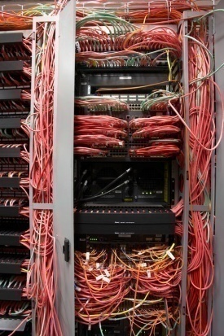
A Network Worm
Multiplies by copying a ___________ of itself onto another computer over a _______________
the segments of the _______, on various ______________ in a network, remain in _____________ with each other
if _____ segment of the worm fails or is removed, then the other ____________ segments must find another computer, _________ it for the worm and then ____ the segment to the rest of the worm
this is how the ______ moves through a network
____________ Worm: a computer worm which copies different _____________ of itself to computers __________ together in a network

Slide 11
A Host Worm
Is completely __________ on _______ running computer
___________ itself to another computer _____________ a network
_________ itself from the __________ computer, once it has moved to another computer
Does not ____________ or ____________ itself
a network worm does run different segments of itself on different computers
______ Worm: a computer worm which _______ itself to another computer in a network and then deletes itself completely from the previous computer in which it was ______________

Slide 12
Similarities of a Worm & Virus
Include:
they both usually contain __________ instructions
designed to harm a computer and annoy a user
they cause an _____________ amount of damage
the more computers the worms or viruses infect the more computers they have access to infect by ___________

Slide 13
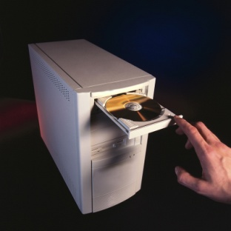
Similarities of a Worm & Virus
Include:
protecting themselves by _______ in _______ programs or changing their ________________ to evade detection
________________ evidence of their presence and wrongdoings
spreading through a ___________, the _________, software, ____________ or memory devices (such as a rewritable CD)
causing system or network ___________

Slide 14
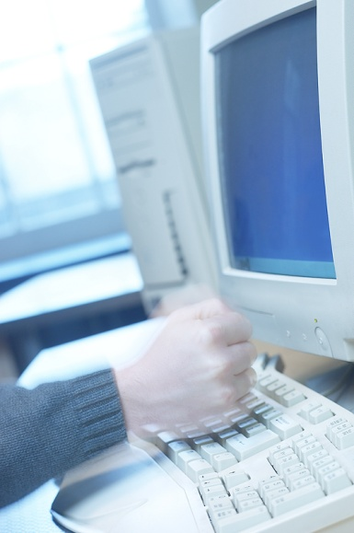
Differences Between a Worm & Virus
Include:
a ______ requires a host program
a ______ is an independent program
a ______ modifies other programs
a _______ usually does not
a ________ only executes when the host program is running
a _______ is always active

Slide 15
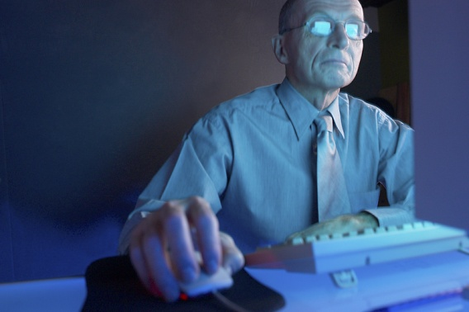
Differences Between a Worm & Virus
Include:
a _______ uses host programs to replicate
a ________ replicates itself over a network
a _______ needs to be activated or downloaded (such as a virus sent through e-mail, it must be double-clicked in order for it to be able to run)
a _______ does not need to be activated
it will move or copy itself to a computer __________ the user’s knowledge

Slide 16
A Summary of Differences
Virus
requires ______ program
Worm
_____________ program
___________ other programs
only active when host is _________
uses host to ________
requires user ________________ to be activated or downloaded
does ____ modify other programs
__________ active and running on the computer
self _____________ over a network
copies itself to a computer ___________ the users permission or knowledge

Slide 17
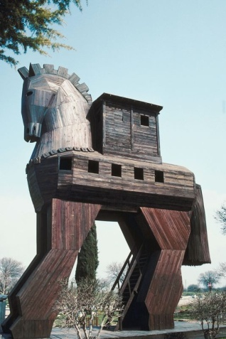
A Trojan Horse
Is a malicious ____________ disguised in a seemingly _____________ program
Is an analogy referencing the “Trojan Horse” used by the Greeks to obtain access to the city of Troy
The Greeks were losing in the battle to overtake the city of Troy, so their leader, Odysseus, built a seemingly innocent giant wooden ________ with a hollow belly, large enough for soldiers to hide in. He offered it to the Trojans as a sign of _______. The Trojans accepted the gift and celebrated their victory. Then at night while they were sleeping, the Greeks snuck out of the horse, which they were hiding in, and took the city of Troy.
___________ Horse: a malicious program __________ inside of another program seemingly beneficial or harmless

Slide 18
A Trojan Horse
Will generally gain access to ______________ areas on a computer
once it has gained access to these areas, it will create a ______ door
this gives the creator of the Trojan horse _____________ access to the user’s computer and the __________________ it contains
Will sometimes ___________ keystrokes and browsing activity
this information is sent to __________ sending the user content and information they did ___ request
Can be _________
meaning they do ____ leave any ________ of their presence

Slide 19
Protecting Against Computer Worms & Viruses

Slide 20
Computer Virus & Worm Laws
Are at both the ______ and _________ level
meaning a __________ can be prosecuted at the state level if the virus did not leave the ______ or at the federal level if it _________ state boundaries
if it is prosecuted at the federal level the U.S. Secret Service will generally _____________
Are usually considered a __________
Can be found on http://www.ncsl.org/programs/lis/cip/viruslaws.htm
this is for ______________ state legislation

Slide 21
Computer Virus & Worm Laws at the Federal Level
Began in _____ with the Computer ______ and Abuse Act
this lays out the prosecution for using the computer for fraud
the ________________varies depending on:
the _________ of damage caused by the ______
if the amount of _________ caused was _________
this would be ___________ to find evidence
if the worm or virus was created for ____________ advantage or ________________ financial gain
the punishment for such a crime is __________________ for up to ____ years and/or a fine
the _______ is decided by a judge

Slide 22
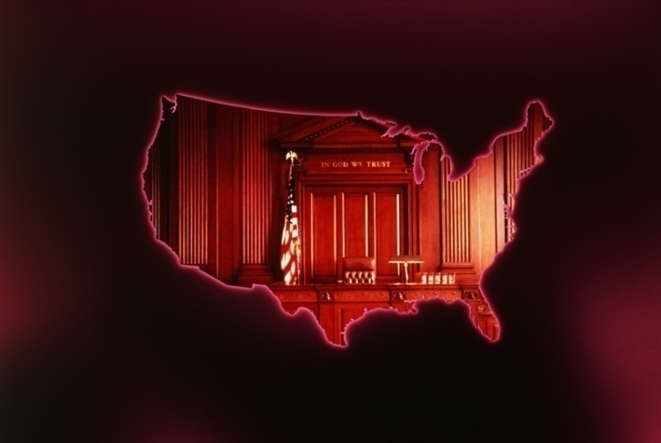
The Computer Fraud & Abuse Act
Was amended in _____ and ______
it was amended because of:
______________ worms and viruses
____________________ issues
the fines and punishments _____________ the _____

Slide 23
Clarification Issues
Arose from distinguishing whether something was a ______, _______ or ___________ horse
the legislation was amended so all of the ________ would fall under the following statement
"transmission of a program, information, code, or command" that "cause[s] ___________ to a computer, computer system, network, information, data or program." 18 U.S.C. Sec. 1030(a)(5)(A).

Slide 24
Protecting a Computer
Against computer worms and viruses comes from _______________ software and ______ judgment from the computer user
use good judgment when __________ suspicious e-mails or ______________ attachments
if it really does not look ____________, then do not open it
viruses in e-mails can find a user’s e-mail list then send itself in an ___________ to all of the contacts on the list

Slide 25
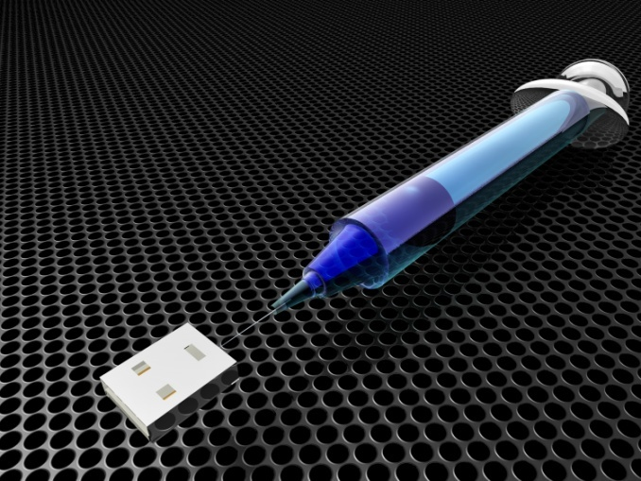
Protecting a Computer
May be completed by ___________ all disks and files used on another computer __________ opening files
this is an easy feature contained in anti-virus software
Requires ________ to _______ attachments and downloads from the Internet by an anti-virus software ___________ opening them

Slide 26
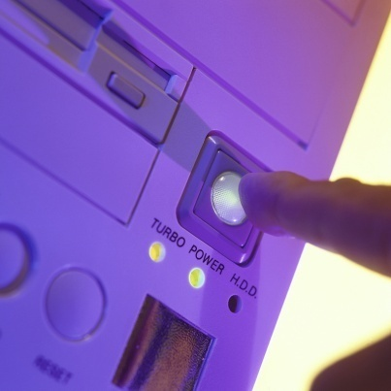
Protecting a Computer
Calls for users in a computer lab to ________ up or “__________” a computer before using
this can be done with a simple action called Disk __________
it can be found by going to Start>All Programs>____________>System Tools> Disk Cleanup
this removes all _____________ harmful ______________ Internet files
also be sure to ____ out when using a ___________ computer

Slide 27
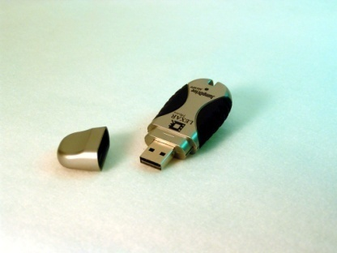
Protecting a Computer
Requires users to _____ up all important information _______________
in case a virus or worm does destroy all files contained on a computer
Involves users to advise _________ when accepting _________ software
sometimes software will be considered ________ domain, where the manufacturer will give it to users at little or no cost
be sure the copied software is from a _______ source

Slide 28
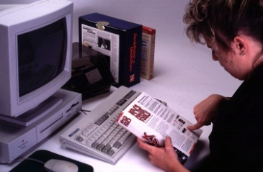
Anti-Virus Software
Is the most _________ form of computer protection against viruses and worms
Was first introduced in _____
Needs to be high-quality
there is _____ anti-virus software on the Internet which will ____ protect a user’s computer as well as a program ______ for
Needs to ____________ regularly
most software will update itself regularly when connected to the ___________, be sure to install all updates possible

Slide 29
Anti-Virus Software
Recommended for Windows® includes:
__________ VirusScan®
__________ AntiVirus®
Recommended for Mac® includes:
__________ Virex®
_________ VirusBarrier®
___________ AntiVirus®

Slide 30
Removing Viruses
Involves detecting, _____________ and deleting viruses
Can be completed by using an anti-virus software or ______________ removing viruses

Slide 31
Removing Viruses
Using an anti-virus software involves:
__________ up the _______– ensure nothing valuable is lost if the computer has to be completely reformatted
making sure the computer problems are _____ caused by other factors– issues with ____________, storage and hardware can significantly slow the computer and ___________ files

Slide 32
Removing Viruses
Using an anti-virus software involves:
____________ the computer into _____ mode– most viruses run themselves by attaching to __________ services when the operating system loads; safe mode can effectively stop ______ viruses from activating
running the ______– run a full __________ scan with the anti-virus program

Slide 33
Removing Viruses
Using an anti-virus software involves:
________________ any files and programs which are questionable
removing viruses by using the _______________ viruses function provided by the anti-virus software
__________ the computer and _______ its performance

Slide 34
Removing Viruses
Manually involves:
_____________ the computer in _______ Mode with Networking– this allows the user to use the Internet to look up the programs which are starting with the computer
running ___________– the program allows users to see exactly what is starting up on the computer when it boots each time

Slide 35
Removing Viruses
Manually involves:
______________ for suspicious entries– pay attention to both the entry’s _______ and the file ____________
______________ the file location of each offending entry– users need to locate these files later to _________ them

Slide 36
Removing Viruses
Manually involves:
_________ the malware-related entry– removing the entry from the startup process, but not any of the inflected files
____________ the files associated with the deleted entry– ______________ to the location which was associated with the startup entry
______________ the computer normally

